Slide 1

Ngoma dza Vhatei uthukela district municipality hospital
Group member
Mukhola Thuso
Maphaha Livhuwani
Muguvhana mbambala
Mohlaha Surprise
Rambau Lindelani

Slide 2

Introduction
Overview of Ngoma Dza Vhatei
  Mission: Enhance connectivity in uThukela
Focus on healthcare improvement
  Supporting local hospitals and clinics
Commitment to sustainable solutions
  Long-term impact and community benefits
Addressing local challenges effectively
  Understanding unique regional needs

Slide 3

Services Offered
Network infrastructure development
  Build reliable, high-speed connections
Internet connectivity solutions
  Tailored packages for healthcare facilities
ICT training programs for staff
  Skill enhancement for effective usage
Security systems implementation
  Protecting data and network integrity
Ongoing technical support and maintenance
  Ensuring operational continuity

Slide 4

Current IT Infrastructure
Main hospital employs 2,000 staff
  Diverse roles: medical and administrative
Limited ICT support: only 5 staff
  Challenges in managing technology
Outdated equipment: 20 old computers
  Inefficient for current demands
Insufficient security measures in place
  Vulnerable to cyber threats
Data storage issues: missing patient files
  Impact on patient care and management

Slide 5

Challenges Faced
Remote location complicates connectivity
  Accessibility issues for infrastructure
Existing infrastructure lacks reliability
  Frequent outages and downtime
High demand with limited resources
  Strain on current IT support
Staff training needs for technology use
  Gaps in technical knowledge
Risk of network security breaches
  Potential data loss and compliance issues

Slide 6

Proposed Solution Overview
Develop dedicated network infrastructure
  Focus on reliability and speed
Partner with Openserve for connectivity
  Utilize established local resources
Upgrade existing hardware and software
  Replace outdated systems with modern tech
Implement robust security protocols
  Safeguard sensitive patient information
Provide comprehensive staff training programs
  Empower staff for effective system use

Slide 7
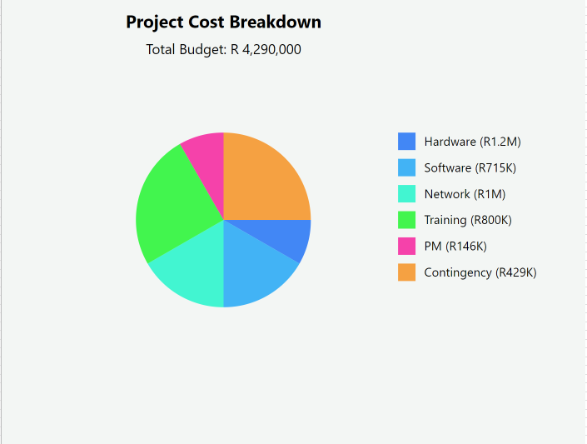

Slide 8

Network Infrastructure Plan
Install new network infrastructure
  Utilize line-of-sight connectivity
Ensure reliable internet access for all
  Address needs of 45 wards
Design network to support patient services
  Prioritize essential healthcare applications
Include backup systems for data security
  Minimize risk of data loss
Create a scalable network for future growth
  Plan for potential expansions

Slide 9

Training and Support
Train ICT staff on new systems
  Hands-on workshops and tutorials
Equip staff with troubleshooting skills
  Focus on common issues and solutions
Provide user training for hospital staff
  Tailored sessions for different roles
Ongoing support to ensure smooth operations
  Help desk and remote assistance
Foster self-sufficiency in IT management
  Encourage internal problem-solving
Training and Support
Train ICT staff on new systems Hands-on
workshops and tutorials Equip staff with troubleshooting skills
Focus on common issues and solutions Provide user training for hospital staff Tailored sessions for different roles Ongoing support to ensure smooth
operations
Help desk and remote assistance Foster self-sufficiency in IT management Encourage internal problem-solving

Slide 10

Expected Outcomes
Improved connectivity for hospital services
  Faster and more reliable access
Enhanced data management and security
  Reduced risk of data breaches
Increased staff efficiency and productivity
  Streamlined operations and processes
Better patient care through technology
  Timely access to patient information
Long-term sustainability of IT infrastructure
  Resilience against future challenges

Slide 11

Implementation Timeline
Project rollout: 1-year plan
  Phased approach for effective management
Initial assessment and planning phase
  Understanding current infrastructure
Infrastructure development and installation
  Timeline for setup and testing
Staff training and system testing
  Schedule for training sessions
Final evaluation and adjustments
  Review performance and address issues

Slide 12
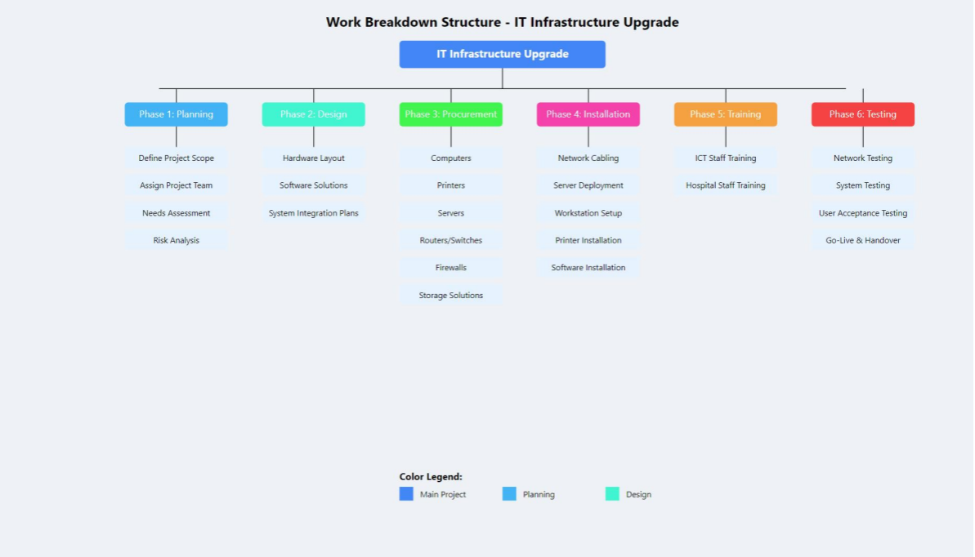

Slide 13

Conclusion
Ngoma Dza Vhatei's commitment to change
  Focus on improving healthcare access
Bridging the digital divide in uThukela
  Importance of connectivity for all
Importance of sustainable IT solutions
  Lasting benefits for the community
Call to action for community support
  Encourage local involvement and partnership
Vision for a connected future in healthcare
  Aspiring for excellence in patient care
Conclusion
Ngoma Dza Vhatei's commitment to
change
Focus on improving healthcare
access
Bridging the digital divide in uThukela Importance of connectivity for all Importance of sustainable IT solutions
Lasting benefits for the community Call to action for community support Encourage local involvement and partnership
Vision for a connected future in healthcare
Aspiring for excellence in patient
care

